Slide 1
Bank Marketing Prediction
Finding top classification model to predict if marketing would lead to a bank term deposit.
This can be impactful to finding profitability for banks.

Slide 2
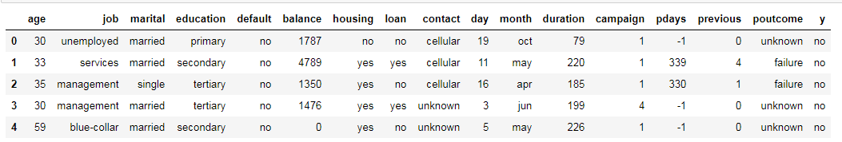
Dataset
https://archive.ics.uci.edu/ml/datasets/bank+marketing
This dataset contains 21 attributes. The ‘y’ field shows if the client subscribes to a bank term deposit or not.

Slide 3
Data attributes
age
job
marital
education
default
housing
Loan
contact: contact communication type (categorical: 'cellular','telephone')
month
day_of_week
duration
Campaign
Pdays
Previous:number of contacts performed before this campaign and for this client (numeric)
Poutcome:outcome of the previous marketing campaign (categorical: 'failure','nonexistent','success')
Emp.var.rate: employment variation rate - quarterly indicator (numeric)
Cons.price.idx: consumer price index - monthly indicator (numeric)
Cons.conf.idx: consumer confidence index - monthly indicator (numeric)
Euribor3m: euribor 3 month rate - daily indicator (numeric)
Nr.employed: number of employees - quarterly indicator (numeric)
y - has the client subscribed a term deposit? (binary: 'yes','no')

Slide 4
Project Design
The goal is to accurately predict if the client will subscribe to a bank term deposit or not, based on the attributes of the data.
The object is to create the best model by increasing accuracy.
Took the data, cleaned the data. Check for null values. Dumified it. Check VIF looking for correlated variables. Scale the data then fit the models. Test each model and tune to maximum possible. Compare output of each model. Figure out most predictive variables in the model.

Slide 5
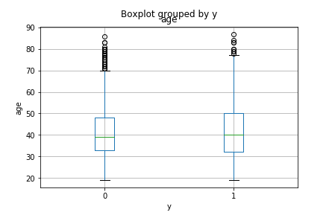
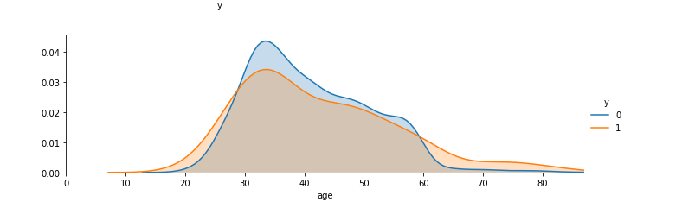
Age and signup
The average age of people who signed up for bank term deposits is slightly higher than those who do not.
Slight increase in users who sign up after 60 years old.

Slide 6
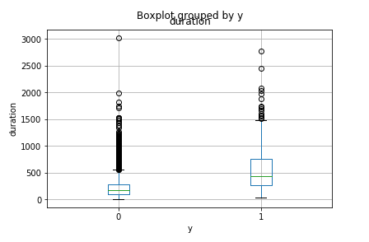
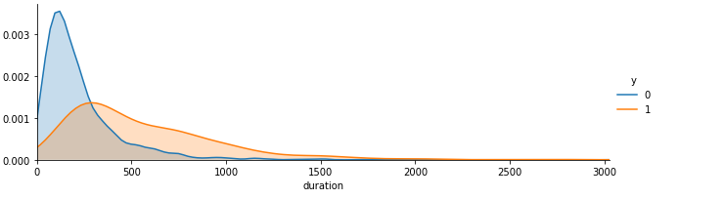
Marketing duration
and signup
There is a correlation with marketers spending more time with users to result in bank term deposit signups.

Slide 7
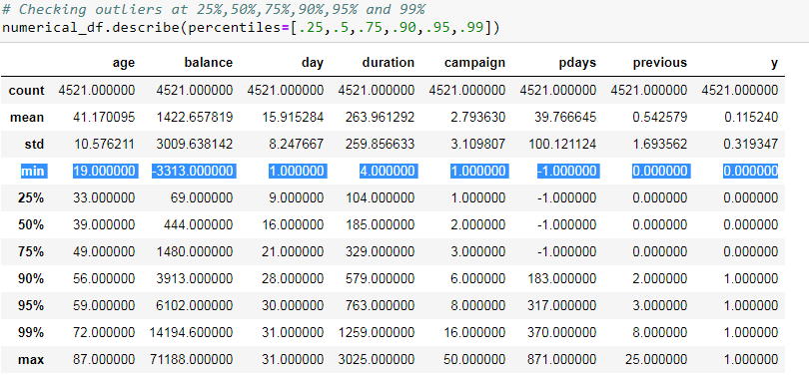
Description of the data

Slide 8
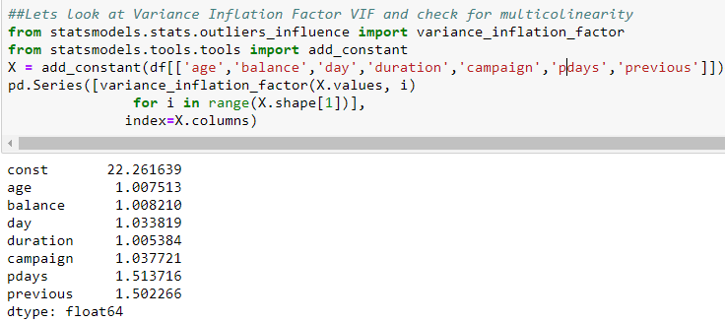
VIF to check for multicollinearity
VIF is low which means that there is no correlation between the dependent variables.

Slide 9
Categorical variables were dummied
job','marital','education','default', 'housing', 'loan', 'contact', 'month','poutcome

Slide 10
Summary of the data
Variables are not correlated.
There were no null values.
Data was scaled.
Dummy variables were created for categorical data.

Slide 11
Base Models
Naive Bayes
KNN Classifier
Logistics Regression
Support Vector Machine
Random Forest
XGBoost

Slide 12
Model Tuning
The models were tuned to see if we can increase our accuracy. We used grid search to find the best combination of parameters with a 3 fold cross validation to get the best accuracy score.

Slide 13
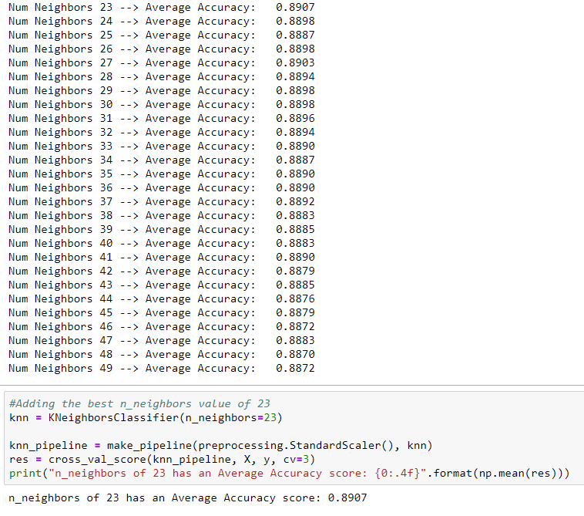
KNN tuning: n_neighbors
N_neighbors were looped through the classifier and 23 produced the best score of 0.8907

Slide 14

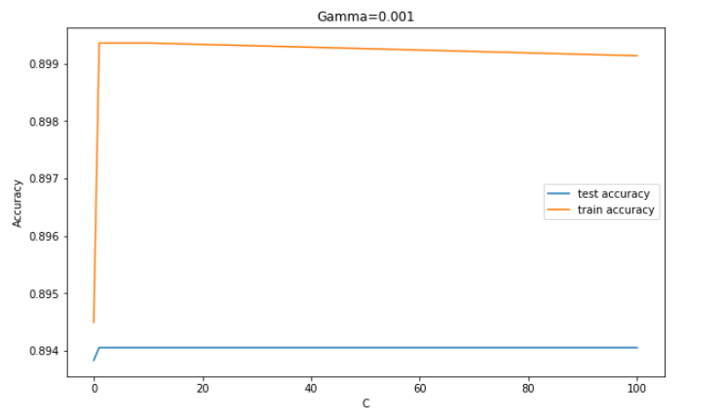
Support Vector Machine tuning
Gamma
C
RESULTS: The highest accuracy score is 0.8940 {'SVM__C': 1, 'SVM__gamma': 0.001}

Slide 15
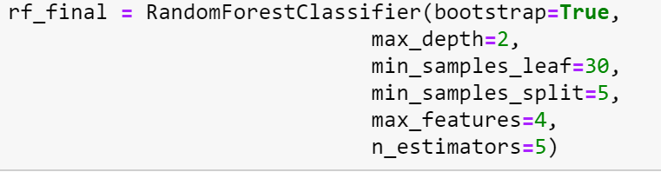
Random Forest Tuning
-max depth
- min samples leaf
-min samples split
-n_estimators
-max features
Results
ADABoostClassifier was used to increase the score The average accuracy score: .8998, better improvement when tuning RFC with AdaBoost.

Slide 16
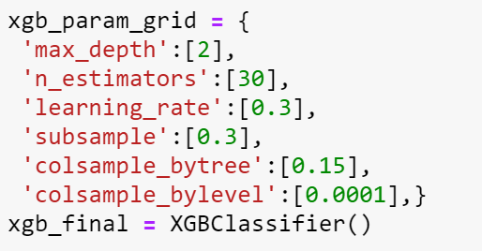
Extreme Gradient Boosting tuning
max depth
Learning rate
n_estimators
subsample
Column Sample by Tree
Column sample by level
Results

Slide 17
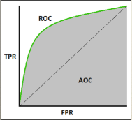
Model Comparison
The metrics used to evaluate the models are the accuracy score and the ROC/AUC.
AUC is the area under the ROC (receiver operating characteristics) curve. ROC shows the performance of the classification at all classification thresholds.
True positive rate = TP/(TP+FN)
False positive rate = FP/(FP+TN)
The goal is to predict if someone would invest in a bank term deposit.

Slide 18
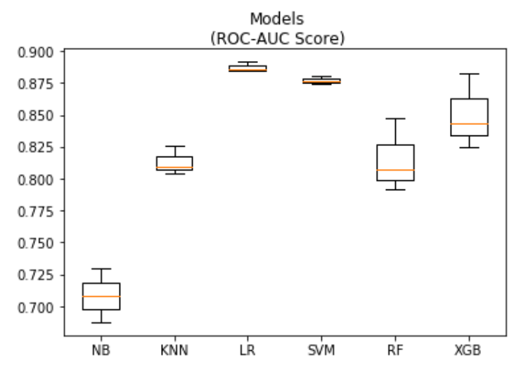
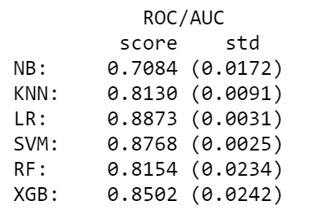
ROC/AUC Model Comparison
-Logistics Regression has the best score
-SVM is the most stable

Slide 19
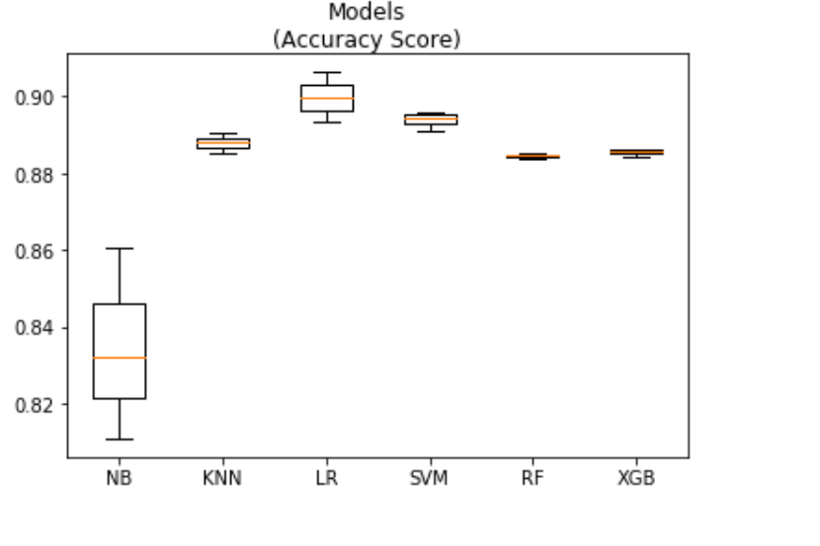
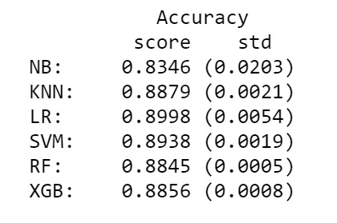
Accuracy Score Model Comparison
Logistics regression has the best score
SVM is the most stable

Slide 20
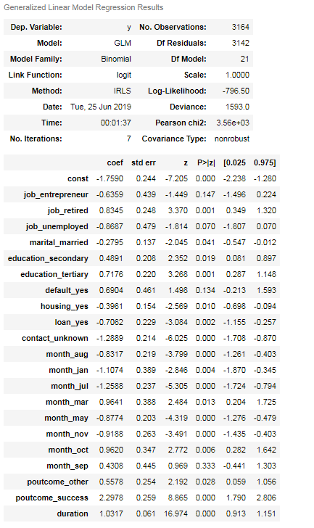
The LR results show P values under .05 being significant

Slide 21
Which Model Wins?
LR (Logistics Regression) is the winning model with the tuned average score of 90% and tuned roc/auc score of 89%.

